Slide 1
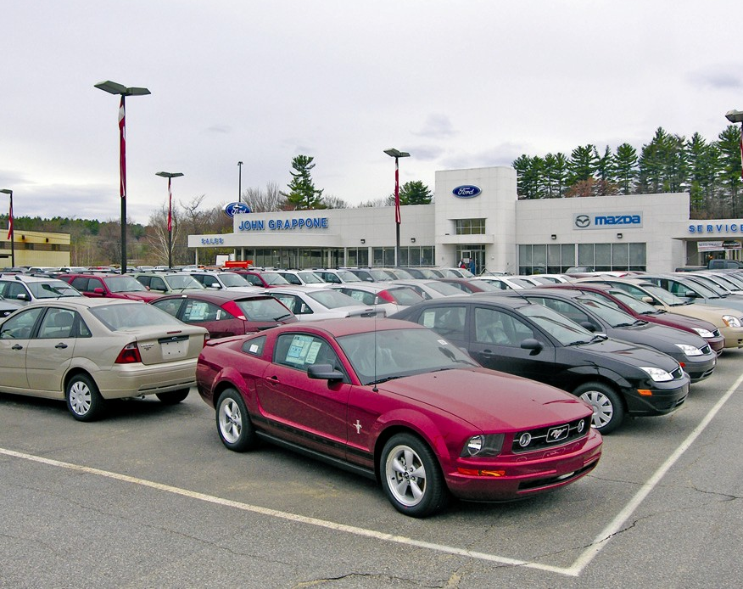
Used car price Predictions
In US
Presented By:
Basem Mohamed Mohamed

Slide 2
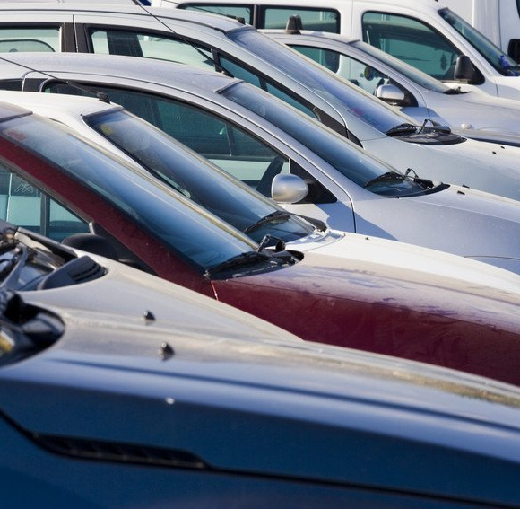
Problem:
A lot of American citizens are facing a lot of problems and thefts due to unknown prices of used cars so, they are searching every day for an application or any way to set determined prices for the used cars to avoid stealing from brokers or owners’ cheats.

Slide 3

Target:
How to deploy a machine learning model which can predict the price of used cars in US based on data consisted.

Slide 4
Data Consisting:
The data is consisted of 852123 rows & 8 columns.
Columns as below:
- Price - Target Variable.
- Year - Year of the car purchased.
- Mileage - The no.of kms drove by the car.
- City - In which city it was sold.
- State - In which state it was sold.
- Vin - a unique number for a car.
- Make - Manufacturer of the car.
- Model - The model(name) of the car.

Slide 5
Data Description
Price | Year | Mileage
count | 852122.000000 | 852122.000000 | 8.521220e+05
mean | 21464.100210 | 2013.289145 | 5.250779e+04
std | 13596.202241 | 3.414987 | 4.198896e+04
min | 1500.000000 | 1997.000000 | 5.000000e+00
25% | 13000.000000 | 2012.000000 | 2.383600e+04
50% | 18500.000000 | 2014.000000 | 4.025600e+04
75% | 26995.000000 | 2016.000000 | 7.218600e+04
max | 499500.000000 | 2018.000000 | 2.856196e+06

Slide 6
Preprocessing
Removing duplicates from data
No Missing Values
No Nulls
Removing outliers
Dropping Vin Column

Slide 7

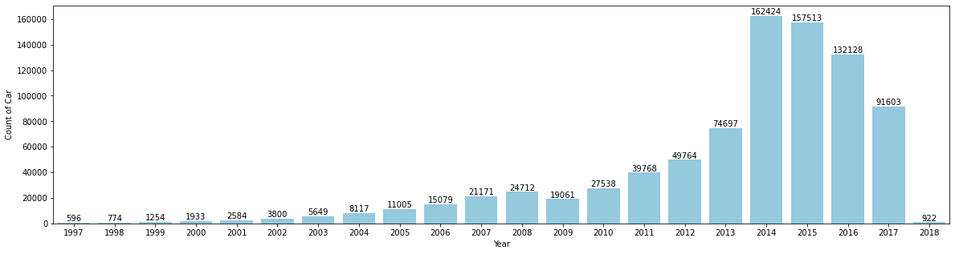
Analyzing Data
Count of sold cars for each year

Slide 8
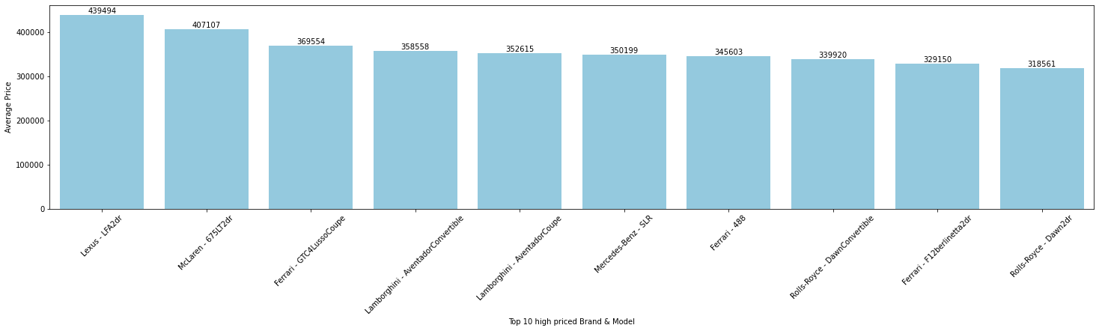
Analyzing Data
Top 10 high priced Brand & Model
Top 10 high priced Brand & Model
Top 10 high priced Brand & Model
Top 10 high priced cars Brand & Model

Slide 9
Max Price
Price | Year | Mileage | City | State | Vin | Make | Model
622265 | 499500 | 2014 | 3260 | Westville | NJ | WDDRJ7HA4EA010693 | Mercedes-Benz | SLS

Slide 10
Min Price
Price | Year | Mileage | City | State | Vin | Make | Model
64010 | 1500 | 2002 | 107885 | Philadelphia | PA | 2G4WS52J321276604 | Buick | Century4dr
64965 | 1500 | 1998 | 100296 | Levittown | PA | 2G4WY52M9W1574802 | Buick | Century4dr
67075 | 1500 | 1998 | 177213 | South Jordan | UT | 1G4CU5219W4643710 | Buick | Park
68710 | 1500 | 1999 | 160000 | Newark | NJ | 2G4WB52K6X1507138 | Buick | Regal4dr
102581 | 1500 | 2009 | 129703 | Lakewood | NJ | KL1TD56E69B664751 | Chevrolet | Aveo4dr
... | ... | ... | ... | ... | ... | ... | ... | ...
699677 | 1500 | 2004 | 220147 | Hillsdale | MI | 1G2NW52E54C120668 | Pontiac | Grand
725042 | 1500 | 2001 | 171087 | Medina | OH | 1G8ZP12821Z215009 | Saturn | SC
799006 | 1500 | 1997 | 274907 | Newark | NJ | 4T1BF22K3VU910383 | Toyota | Camry4dr
838989 | 1500 | 2001 | 136301 | McCook | IL | WVWPD63B61P285315 | Volkswagen | New
851197 | 1500 | 2002 | 181020 | Newark | NJ | YV1RS61RX22195947 | Volvo | S602.4

Slide 11
The Best Model
Linear Regression

Slide 12
Thanks

